Slide 1
Instructions for exporting as PDF
Go to File > Export…
Select the file format as PDF
Be sure to select the “Best for printing” option
This will help prevent the PDF from being pixelated and provide the best quality option for printing.

Slide 2
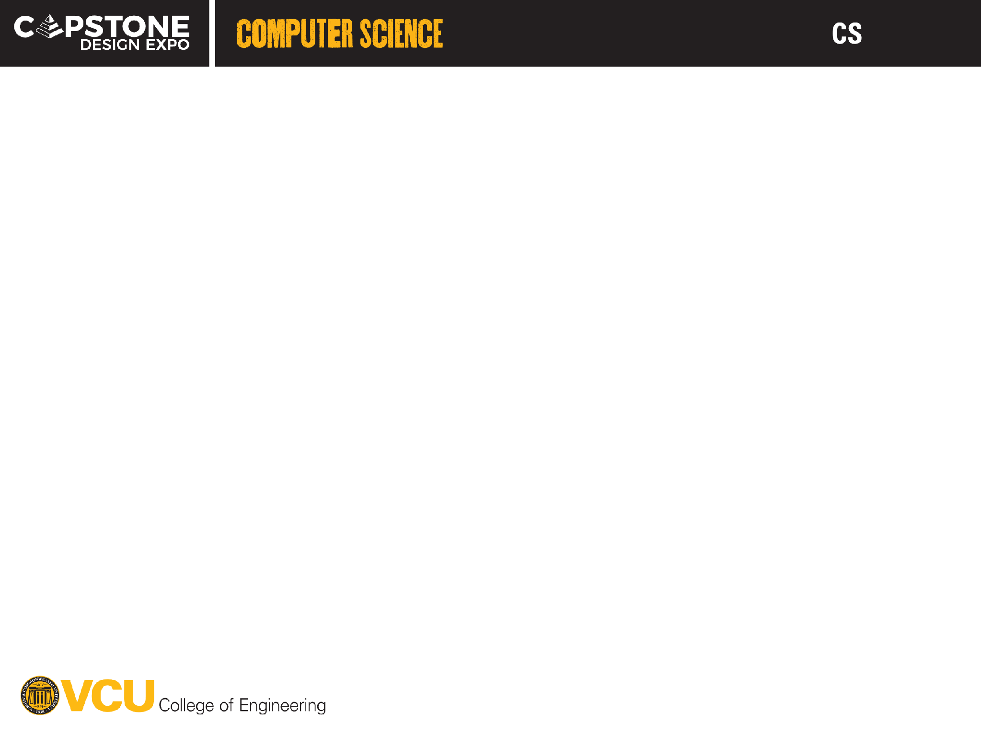


















27-308
ROAD - Radiation Oncology Aggregated Dashboard
Team members: Robert Smith | Adalberto Gomez | Alycia Logan | Blake Cottrill | Faculty adviser: K. Harahsheh, Ph.D. | Sponsor: VCU Health: Tianjun Ma | Mentor: Dr. Thomas Gyeera, Ph.D.
Problem Statement & Project Objectives
Proposed Solution
Technical Approach & Tools/Tech
Problem Statement
ROAD is a web based clinical dashboard that integrates information from existing radiation oncology systems into a single united platform. It consolidates, normalizes, and organizes data to provide users with a consistent and intuitive interface for accessing relevant clinical information.
The proposed architecture utilizes MySQL as the relational database to store clinical data, a Python based Django backend to manage data processing and API communication, and a NiceGUI frontend to present information through role-based dashboards. Microsoft Entra ID will provide secure user authentication and role-based access controls will restrict information according to assigned user permissions.
Technical Approach
VCU Health’s Department of Radiation Oncology relies on multiple independent clinical systems, including but not limited to Epic, ARIA, PACS, MIM, and Eclipse. They use these systems to manage patient information, treatment planning, and the clinical workflow. The problem with this current structure is that the separation of these systems creates fragmented information, inconsistent data formats, and makes the workflow much more inefficient.
Our technical approach focuses on developing a centralized dashboard that integrates and organizes data from EPIC, ARIA, Eclipse, MIM, PACS. The goal is to provide different roles with a unified platform where clinical information can be accessed, monitored, and analyzed for team members based on roles. mySQL will be used for the holding client data, Django will provide data manipulation resources, Microsoft Entra ID for authentication and Nice GUI for the frontend
Problem Objectives
Normalize Information
Standardize data in a structured relational database
Tools/Tech
Consolidate Data
Unite information from multiple clinical sources
High-level python web framework for data processing and API communication
Cloud-based identity and access management service that provides authentication
Role-Based Dashboard
Provide personalized interfaces for authorized users
Secure Authentication
Integrate Microsoft Entra ID for enterprise sign-in
Scalability & Workflow
Support future updates, improve info accessibility and department workflow
Open-source relational database management system using SQL
Python-based framework that allows developers to create web-based user interfaces
System Design (Architecture)
Clinical Systems/Data Sources
Authentification
Planned Features/Functionality
Microsoft Entra ID
Challenges, next steps, and future improvements
Appointment Scheduling
Patients can utilize the web application to schedule appointments at VCU Health. Users with the correct roles can modify and edit these scheduled appointments whenever necessary.
Challenges
Next Steps
Data Integration
Structured Database
User Interface
Maintaining two different loop servers when running NiceGUI and Django together.
Initializing Django repository and configure it to use MySQL as the primary database.
Security & Encryption
Users will need a login in order to access the backend database. Sensitive information contained by the application will be encrypted and stored in a secure place.
Building five different custom data adapter layers in Django.
Implement Microsoft Entra ID authentication within Django.
Collect.
Validate.
Normalize.
Use Entra ID for authentication and be able seamlessly connect it to NiceGUI websockets while enforcing medical roles access.
Establish a digital bridge between NiceGUI and Django.
Microsoft Entra ID Authentication
Users will need to use Microsoft Entra to authenticate, in accordance with VCU Health standards.
REST API
Design a User state database schema using MySQL and Django data.
Backend
Future Improvements
Users will be assigned different roles within the system. Each role will have access to different features and permissions within the application, presenting varying levels of control through the frontend.
Building an AI chatbot that can parse dense text reports from Radiology into a clear and comfortable bulleted summary.
Role-Based Dashboard
Integrating continuous security verification through Entra ID like Windows Hello to ensure patients data protected when radiologist step away from a multi-monitor workspace.
Building a visual radiation oncology journey that puts together historical scans from Radiology Online, current dosimetry plans in Eclipse, and future chemotherapy visits in Epic into a single chart.

